Slide 1
Code Complete
Steve McConnell

Slide 2
6. Working Classes

Slide 3
In the dawn of computing, programmers thought about programming in terms of statements. Throughout the 1970s and 1980s, programmers began thinking about programs in terms of routines. In the twenty-first century, programmers think about programming in terms of classes.
A class is a collection of data and routines that share a cohesive, well-defined responsibility. A class might also be a collection of routines that provides a cohesive set of services even if no common data is involved. A key to being an effective programmer is maximizing the portion of a program that you can safely ignore while working on any one section of code. Classes are the primary tool for accomplishing that objective.
This presentation contains a distillation of advice in creating high quality classes.

Slide 4
6.1. Class Foundations: Abstract Data Types (ADTs)
An abstract data type is a collection of data and operations that work on that data. The operations both describe the data to the rest of the program and allow the rest of the program to change the data. The word “data” in “abstract data type” is used loosely. An ADT might be a graphics window with all the operations that affect it; a file and file operations; an insurance-rates table and the operations on it; or something else.
Understanding ADTs is essential to understanding object-oriented programming. Without understanding ADTs, programmers create classes that are “classes” in name only—in reality, they are little more than convenient carrying cases for loosely related collections of data and routines. With an understanding of ADTs, programmers can create classes that are easier to implement initially and easier to modify over time.
Traditionally, programming books wax mathematical when they arrive at the topic of abstract data types. They tend to make statements like “One can think of an abstract data type as a mathematical model with a collection of operations defined on it.” Such books make it seem as if you’d never actually use an abstract data type except as a sleep aid.

Slide 5
6.1. Class Foundations: Abstract Data Types (ADTs)
Such dry explanations of abstract data types completely miss the point. Abstract data types are exciting because you can use them to manipulate real-world entities rather than low-level, implementation entities. Instead of inserting a node into a linked list, you can add a cell to a spreadsheet, a new type of window to a list of window types, or another passenger car to a train simulation. Tap into the power of being able to work in the problem domain rather than at the low-level implementation domain!
6.1.1. Example of the Need for an ADT
To get things started, here’s an example of a case in which an ADT would be useful. We’ll get to the theoretical details after we have an example to talk about.
Suppose you’re writing a program to control text output to the screen using a variety of typefaces, point sizes, and font attributes (such as bold and italic). Part of the program manipulates the text’s fonts. If you use an ADT, you’ll have a group of font routines bundled with the data—the typeface names, point sizes and font attributes—they operate on. The collection of font routines and data is an ADT.

Slide 6
6.1. Class Foundations: Abstract Data Types (ADTs)
If you’re not using ADTs, you’ll take an ad hoc approach to manipulating fonts. For example, if you need to change to a 12-point font size, which happens to be 16 pixels high, you’ll have code like this:
currentFont.size = 16
If you’ve built up a collection of library routines, the code might be slightly
more readable:
currentFont.size = PointsToPixels( 12 )
Or you could provide a more specific name for the attribute, something like
currentFont.sizeInPixels = PointsToPixels( 12 )
But what you can’t do is have both currentFont.sizeInPixels and currentFont.sizeInPoints, because, if both the data members are in play, currentFont won’t have any way to know which of the two it should use.
If you change sizes in several places in the program, you’ll have similar lines spread throughout your program.

Slide 7
6.1. Class Foundations: Abstract Data Types (ADTs)
If you need to set a font to bold, you might have code like this:
currentFont.attribute = currentFont.attribute or 0x02
If you’re lucky, you’ll have something cleaner than that, but the best you’ll get with an ad hoc approach is something like this:
currentFont.attribute = currentFont.attribute or BOLD
Or maybe something like this:
currentFont.bold = True
As with the font size, the limitation is that the client code is required to control the data members directly, which limits how currentFont can be used.
If you program this way, you’re likely to have similar lines in many places in your program.

Slide 8
6.1. Class Foundations: Abstract Data Types (ADTs)
6.1.2. Benefits of Using ADTs
The problem isn’t that the ad hoc approach is bad programming practice. It’s that you can replace the approach with a better programming practice that produces these benefits:
You can hide implementation details
Hiding information about the font data type means that if the data type changes, you can change it in one place without affecting the whole program. For example, unless you hid the implementation details in an ADT, changing the data type from the first representation of bold to the second would entail changing your program in every place in which bold was set rather than in just one place. Hiding the information also protects the rest of the program if you decide to store data in external storage rather than in memory or to rewrite all the font-manipulation routines in another language.
Changes don’t affect the whole program
If fonts need to become richer and support more operations (such as switching to small caps, superscripts, strikethrough, and so on), you can change the program in one place. The change won’t affect the rest of the program.

Slide 9
6.1. Class Foundations: Abstract Data Types (ADTs)
You can make the interface more informative
Code like currentFont.size = 16 is ambiguous because 16 could be a size in either pixels or points. The context doesn’t tell you which is which. Collecting all similar operations into an ADT allows you to define the entire interface in terms of points, or in terms of pixels, or to clearly differentiate between the two, which helps avoid confusing them.
It’s easier to improve performance
If you need to improve font performance, you can recode a few well-defined routines rather than wading through an entire program.
The program is more obviously correct
You can replace the more tedious task of verifying that statements like currentFont.attribute = currentFont.attribute or 0x02 are correct with the easier task of verifying that calls to currentFont.BoldOn() are correct. With the first statement, you can have the wrong structure name, the wrong field name, the wrong logical operation (a logical and instead of or), or the wrong value for the attribute (0x20 instead of 0x02). In the second case, the only thing that could possibly be wrong with the call to currentFont.BoldOn() is that it’s a call to the wrong routine name, so it’s easier to see whether it’s correct.

Slide 10
6.1. Class Foundations: Abstract Data Types (ADTs)
The program becomes more self-documenting
You can improve statements like currentFont.attribute or 0x02 by replacing 0x02 with BOLD or whatever 0x02 represents, but that doesn’t compare to the readability of a routine call such as currentFont.BoldOn().
You don’t have to pass data all over your program
In the examples just presented, you have to change currentFont directly or pass it to every routine that works with fonts. If. you use an abstract data type, you don’t have to pass currentFont all over the program and you don’t have to turn it into global data either. The ADT has a structure that contains currentFont’s data. The data is directly accessed only by routines that are part of the ADT. Routines that aren’t part of the ADT don’t have to worry about the data.
You’re able to work with real-world entities rather than with low-level implementation structures
You can define operations dealing with fonts so that most of the program operates solely in terms of fonts rather than in terms of array accesses, structure definitions, and True and False booleans.

Slide 11
6.1. Class Foundations: Abstract Data Types (ADTs)
In this case, to define an abstract data type, you’d define a few routines to control fonts—perhaps these:
currentFont.SetSizeInPoints( sizeInPoints )
currentFont.SetSizeInPixels( sizeInPixels )
currentFont.BoldOn()
currentFont.BoldOff()
currentFont.ItalicOn()
currentFont.ItalicOff()
currentFont.SetTypeFace( faceName )
The code inside these routines would probably be short—it would probably be similar to the code you saw in the ad hoc approach to the font problem earlier. The difference is that you’ve isolated font operations in a set of routines. That provides a better level of abstraction for the rest of your program to work with fonts, and it gives you a layer of protection against changes in font operations.

Slide 12
6.1. Class Foundations: Abstract Data Types (ADTs)
6.1.3. More Examples of ADTs
Here are a few more examples of ADTs:
Suppose you’re writing software that controls the cooling system for a nuclear reactor. You can treat the cooling system as an abstract data type by defining the following operations for it:
coolingSystem.Temperature()
coolingSystem.SetCirculationRate( rate )
coolingSystem.OpenValve( valveNumber )
coolingSystem.CloseValve( valveNumber )
The specific environment would determine the code written to implement each of these operations. The rest of the program could deal with the cooling system through these functions and wouldn’t have to worry about internal details of data-structure implementations, data-structure limitations, changes, and so on.

Slide 13
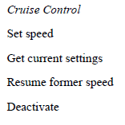
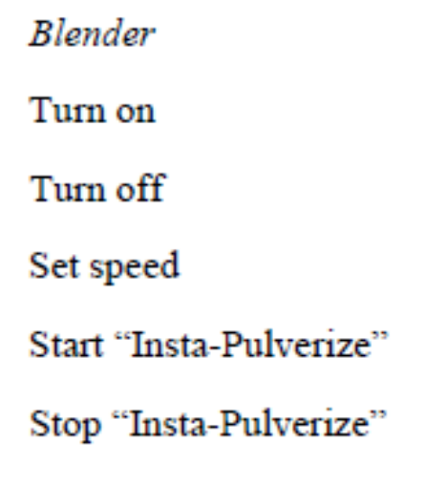
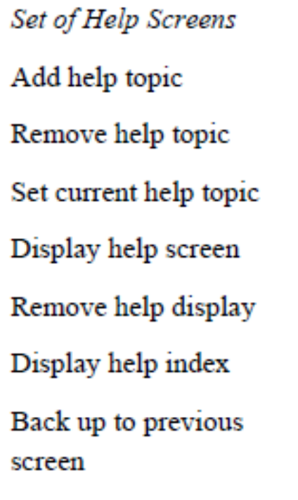
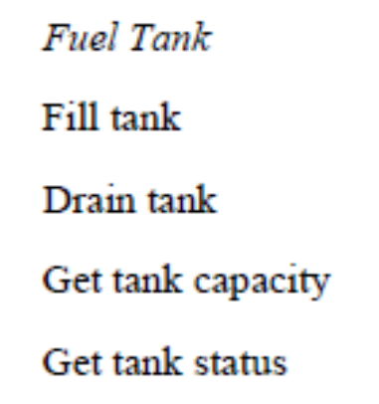
6.1. Class Foundations: Abstract Data Types (ADTs)
Here are more examples of abstract data types and likely operations on them:

Slide 14
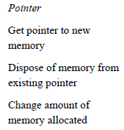
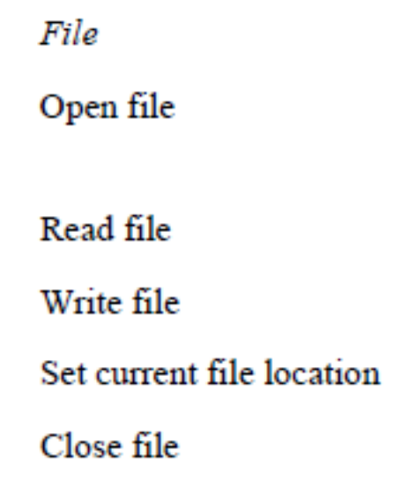
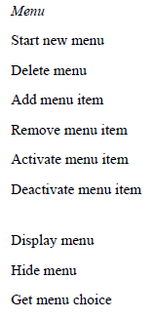
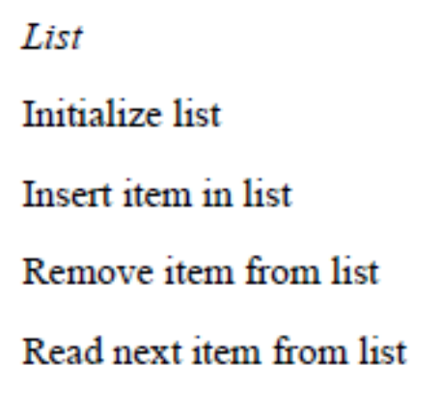
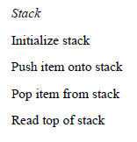
6.1. Class Foundations: Abstract Data Types (ADTs)
Here are more examples of abstract data types and likely operations on them:

Slide 15
6.1. Class Foundations: Abstract Data Types (ADTs)
Yon can derive several guidelines from a study of these examples:
Build or use typical low-level data types as ADTs, not as low-level data types
Most discussions of ADTs focus on representing typical low-level data types as ADTs. As you can see from the examples, you can represent a stack, a list, and a queue, as well as virtually any other typical data type, as an ADTs.
The question you need to ask is, What does this stack, list, or queue represent? If a stack represents a set of employees, treat the ADT as employees rather than as a stack. If a list represents a set of billing records, treat it as billing records rather than a list. If a queue represents cells in a spreadsheet, treat it as a collection of cells rather than a generic item in a queue. Treat yourself to the highest possible level of abstraction.

Slide 16
6.1. Class Foundations: Abstract Data Types (ADTs)
Treat common objects such as files as ADTs
Most languages include a few abstract data types that you’re probably familiar with but might not think of as ADTs. File operations are a good example. While writing to disk, the operating system spares you the grief of positioning the read/write head at a specific physical address, allocating a new disk sector when you exhaust an old one, and checking for binary error codes. The operating system provides a first level of abstraction and the ADTs for that level. High level languages provide a second level of abstraction and ADTs for that higher level. A high-level language protects you from the messy details of generating operating-system calls and manipulating data buffers. It allows you to treat a chunk of disk space as a “file.”
You can layer ADTs similarly. If you want to use an ADT at one level that offers data-structure level operations (like pushing and popping a stack), that’s fine. You can create another level on top of that one that works at the level of the real world problem.

Slide 17
6.1. Class Foundations: Abstract Data Types (ADTs)
Treat even simple items as ADTs
You don’t have to have a formidable data type to justify using an abstract data type. One of the ADTs in the example list is a light that supports only two operations—turning it on and turning it off. You might think that it would be a waste to isolate simple “on” and “off” operations in routines of their own, but even simple operations can benefit from the use of ADTs. Putting the light and its operations into an ADT makes the code more self-documenting and easier to change, confines the potential consequences of changes to the TurnLightOn() and TurnLightOff() routines, and reduces the amount of data you have to pass around.
Refer to an ADT independently of the medium it’s stored on
Suppose you have an insurance-rates table that’s so big that it’s always stored on disk. You might be tempted to refer to it as a “rate file” and create access routines such as rateFile.Read(). When you refer to it as a file, however, you’re exposing more information about the data than you need to. Try to make the names of classes and access routines independent of how the data is stored, and refer to the abstract data type, like the insurance-rates table, instead. That would give your class and access routine names like rateTable.Read() or simply rates.Read().

Slide 18
6.1. Class Foundations: Abstract Data Types (ADTs)
6.1.4. ADTs and Classes
Abstract data types form the foundation for the concept of classes. In languages that support classes, you can implement each abstract data type in its own class.
Classes usually involve the additional concepts of inheritance and polymorphism. One way of thinking of a class is as an abstract data type plus inheritance and polymorphism.

Slide 19
6.2 Good Class Interfaces
The first and probably most important step in creating a high quality class is creating a good interface. This consists of creating a good abstraction for the interface to represent and ensuring the details remain hidden behind the abstraction.
6.2.1. Good Abstraction
As “Form Consistent Abstractions” in Section 5.3 discussed, abstraction is the ability to view a complex operation in a simplified form. A class interface provides an abstraction of the implementation that’s hidden behind the interface.
The class’s interface should offer a group of routines that clearly belong together.
You might have a class that implements an employee. It would contain data describing the employee’s name, address, phone number, and so on. It would offer services to initialize and use an employee.
Here’s how that might look.

Slide 20
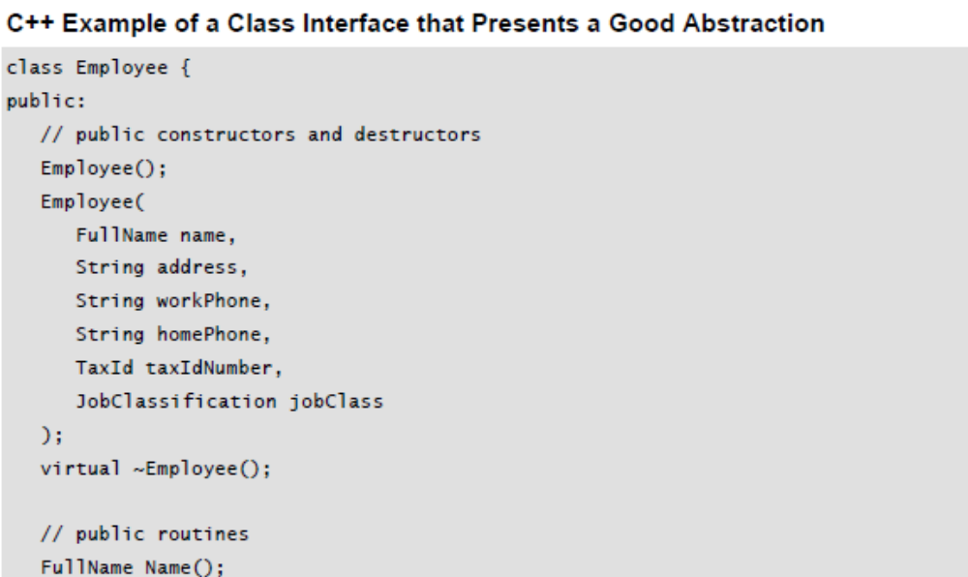
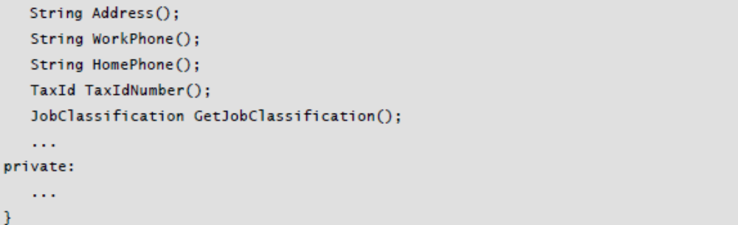
6.2 Good Class Interfaces

Slide 21
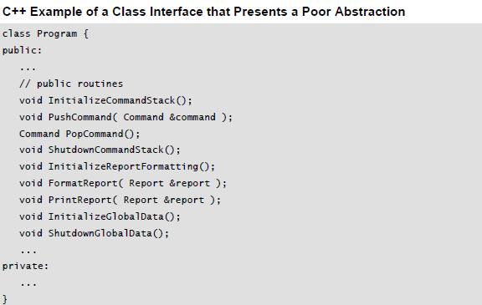
6.2 Good Class Interfaces

Slide 22
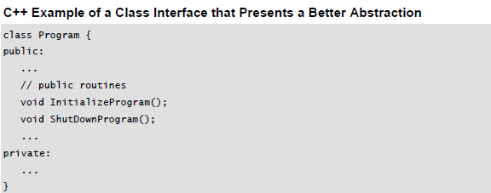
6.2 Good Class Interfaces
Suppose that a class contains routines to work with a command stack, format reports, print reports, and initialize global data. It’s hard to see any connection among the command stack and report routines or the global data. The class interface doesn’t present a consistent abstraction, so the class has poor cohesion.
The routines should be reorganized into more-focused classes, each of which provides a better abstraction in its interface.
If these routines were part of a “Program” class, they could be revised to present a consistent abstraction.

Slide 23
6.2 Good Class Interfaces
The cleanup of this interface assumes that some of these routines were moved to other, more appropriate classes and some were converted to private routines used by InitializeProgram() and ShutDownProgram().
This evaluation of class abstraction is based on the class’s collection of public routines, that is, its class interface. The routines inside the class don’t necessarily present good individual abstractions just because the overall class does, but they need to be designed to present good abstractions, too.
The pursuit of good, abstract interfaces gives rise to several guidelines for creating class interfaces.

Slide 24
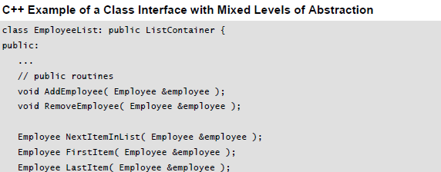
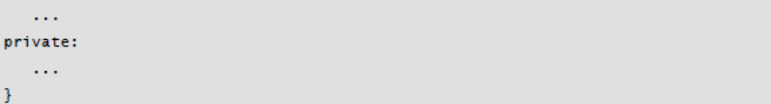
6.2 Good Class Interfaces
Present a consistent level of abstraction in the class interface
A good way to think about a class is as the mechanism for implementing the abstract data types (ADTs). Each class should implement one and only one ADT. If you find a class implementing more than one ADT, or if you can’t determine what ADT the class implements, it’s time to reorganize the class into one or more well-defined ADTs.
Here’s an example of a class the presents an interface that’s inconsistent because its level of abstraction is not uniform:

Slide 25
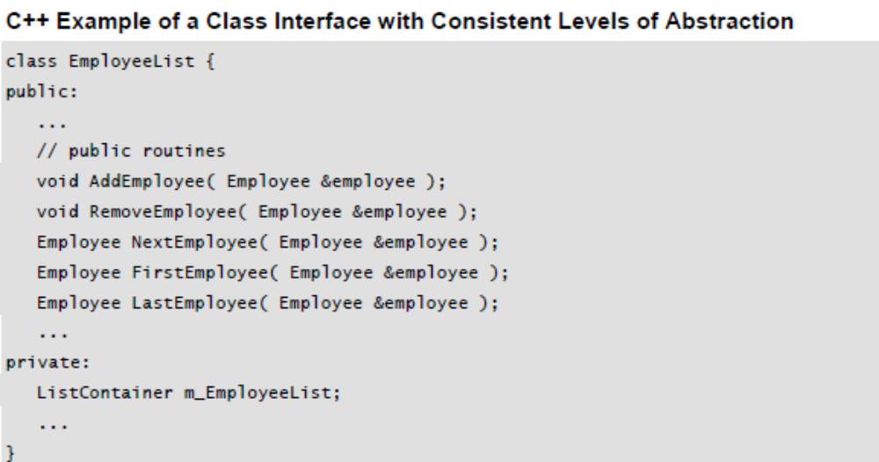
6.2 Good Class Interfaces
This class is presenting two ADTs: an Employee and a ListContainer. This sort of mixed abstraction commonly arises when a programmer uses a container class or other library classes for implementation and doesn’t hide the fact that a library class is used. Ask yourself whether the fact that a container class is used should be part of the abstraction. Usually that’s an implementation detail that should be hidden from the rest of the program, like this:

Slide 26
6.2 Good Class Interfaces
Programmers might argue that inheriting from ListContainer is convenient because it supports polymorphism, allowing an external search or sort function that takes a ListContainer object. That argument fails the main test for inheritance, which is, Is inheritance used only for “is a” relationships? To inherit from ListContainer would mean that EmployeeList “is a” ListContainer, which obviously isn’t true. If the abstraction of the EmployeeList object is that it can be searched or sorted, that should be incorporated as an explicit, consistent part of the class interface.
If you think of the class’s public routines as an air lock that keeps water from getting into a submarine, inconsistent public routines are leaky panels in the class. The leaky panels might not let water in as quickly as an open air lock, but if you give them enough time, they’ll still sink the boat. In practice, this is what happens when you mix levels of abstraction. As the program is modified, the mixed levels of abstraction make the program harder and harder to understand, and it gradually degrades until it becomes unmaintainable.

Slide 27
6.2 Good Class Interfaces
Be sure you understand what abstraction the class is implementing
Some classes are similar enough that you must be careful to understand which abstraction the class interface should capture. I once worked on a program that needed to allow information to be edited in a table format. We wanted to use a simple grid control, but the grid controls that were available didn’t allow us to color the data-entry cells, so we decided to use a spreadsheet control that did provide that capability.
The spreadsheet control was far more complicated than the grid control, providing about 150 routines to the grid control’s 15. Since our goal was to use a grid control, not a spreadsheet control, we assigned a programmer to write a wrapper class to hide the fact that we were using a spreadsheet control as a grid control. The programmer grumbled quite a bit about unnecessary overhead and bureaucracy, went away, and came back a couple days later with a wrapper class that faithfully exposed all 150 routines of the spreadsheet control.

Slide 28
6.2 Good Class Interfaces
This was not what was needed. We wanted a grid-control interface that encapsulate the fact that, behind the scenes, we were using a much more complicated spreadsheet control. The programmer should have exposed just the 15 grid control routines plus a 16th routine that supported cell coloring. By exposing all 150 routines, the programmer created the possibility that, if we ever wanted to change the underlying implementation, we could find ourselves supporting 150 public routines. The programmer failed to achieve the encapsulation we were looking for, as well as creating a lot more work for himself than necessary.
Depending on specific circumstances, the right abstraction might be either a spreadsheet control or a grid control. When you have to choose between two similar abstractions, make sure you choose the right one.

Slide 29
6.2 Good Class Interfaces
Provide services in pairs with their opposites
Most operations have corresponding, equal, and opposite operations. If you have an operation that turns a light on, you’ll probably need one to turn it off. If you have an operation to add an item to a list, you’ll probably need one to delete an item from the list. If you have an operation to activate a menu item, you’ll probably need one to deactivate an item. When you design a class, check each public routine to determine whether you need its complement. Don’t create an opposite gratuitously, but do check to see whether you need one.
Move unrelated information to another class
In some cases, you’ll find that half a class’s routines work with half the class’s data, and half the routines work with the other half of the data. In such a case, you really have two classes masquerading as one. Break them up!

Slide 30
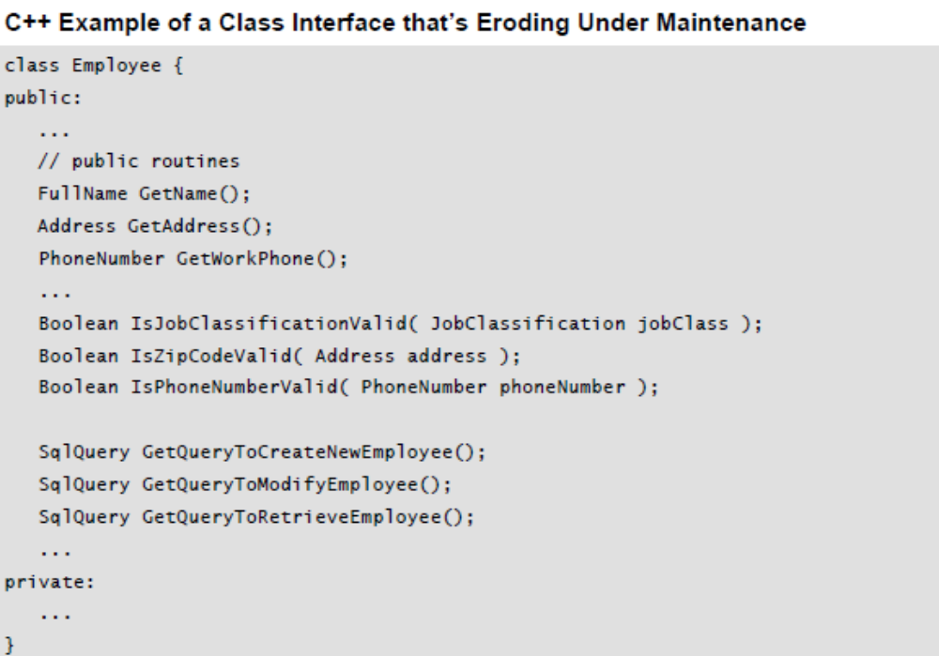
6.2 Good Class Interfaces
Beware of erosion of the interface’s abstraction under modification
As a class is modified and extended, you often discover additional functionality that’s needed, that doesn’t quite fit with the original class interface, but that seems too hard to implement any other way. For example, in the Employee class, you might find that the class evolves to look like this:

Slide 31
6.2 Good Class Interfaces
What started out as a clean abstraction in an earlier code sample has evolved into a hodgepodge of functions that are only loosely related. There’s no logical connection between employees and routines that check zip codes, phone numbers, or job classifications. The routines that expose SQL query details are at a much lower level of abstraction than the Employee class, and they break the Employee abstraction.
Don’t add public members that are inconsistent with the interface abstraction
Each time you add a routine to a class interface, ask, “Is this routine consistent with the abstraction provided by the existing interface?” If not, find a different way to make the modification, and preserve the integrity of the abstraction.
Consider abstraction and cohesion together
The ideas of abstraction and cohesion are closely related—a class interface that presents a good abstraction usually has strong cohesion. Classes with strong cohesion tend to present good abstractions, although that relationship is not as strong.

Slide 32
6.2 Good Class Interfaces
6.2.1. Good Encapsulation
As Section 5.3 discussed, encapsulation is a stronger concept than abstraction. Abstraction helps to manage complexity by providing models that allow you to ignore implementation details. Encapsulation is the enforcer that prevents you from looking at the details even if you want to.
The two concepts are related because, without encapsulation, abstraction tends to break down. In my experience either you have both abstraction and encapsulation, or you have neither. There is no middle ground.
Minimize accessibility of classes and members
Minimizing accessibility is one of several rules that are designed to encourage encapsulation. If you’re wondering whether a specific routine should be public, private, or protected, one school of thought is that you should favor the strictest level of privacy that’s workable (Meyers 1998, Bloch 2001). I think that’s a fine guideline, but I think the more important guideline is, “What best preserves the integrity of the interface abstraction?” If exposing the routine is consistent with the abstraction, it’s probably fine to expose it. If you’re not sure, hiding more is generally better than hiding less.

Slide 33
6.2 Good Class Interfaces
Don’t expose member data in public
Exposing member data is a violation of encapsulation and limits your control over the abstraction. As Arthur Riel points out, a Point class that exposes
float x;
float y;
float z;
is violating encapsulation because client code is free to monkey around with Point’s data, and Point won’t necessarily even know when its values have been changed (Riel 1996). However, a Point class that exposes
float X();
float Y();
float Z();
void SetX( float x );
void SetY( float y );
void SetZ( float z );
is maintaining perfect encapsulation.

Slide 34
6.2 Good Class Interfaces
You have no idea whether the underlying implementation is in terms of floats x, y, and z, whether Point is storing those items as doubles and converting them to floats, or whether Point is storing them on the moon and retrieving them from a satellite in outer space.
Don’t put private implementation details in a class’s interface
With true encapsulation, programmers would not be able to see implementation details at all. They would be hidden both figuratively and literally. In popular languages like C++, however, the structure of the language requires programmers to disclose implementation details in the class interface. Here’s an example:

Slide 35
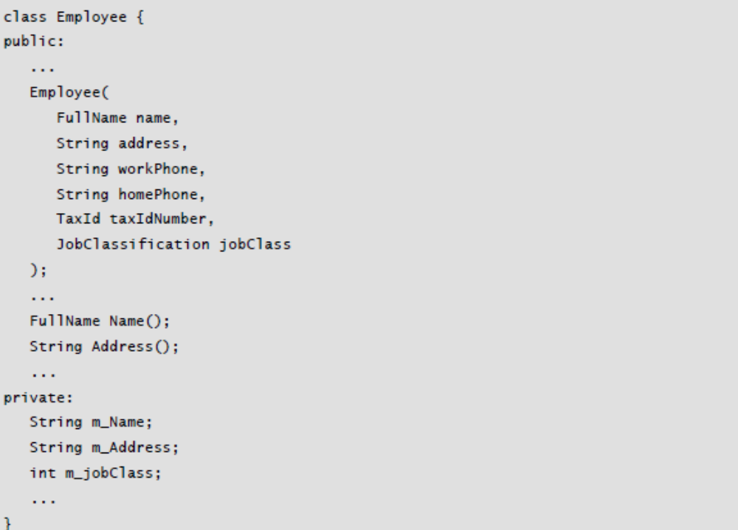
6.2 Good Class Interfaces

Slide 36
6.2 Good Class Interfaces
Including private declarations in the class header file might seem like a small transgression, but it encourages programmers to examine the implementation details. In this case, the client code is intended to use the Address type for addresses, but the header file exposes the implementation detail that addresses are stored as Strings.
As the writer of a class in C++, there isn’t much you can do about this without going to great lengths that usually add more complexity than they’re worth. As the reader of a class, however, you can resist the urge to comb through the private section of the class interface looking for implementation clues.

Slide 37
6.2 Good Class Interfaces
Don’t make assumptions about the class’s users
A class should be designed and implemented to adhere to the contract implied by the class interface. It shouldn’t make any assumptions about how that interface will or won’t be used, other than what’s documented in the interface. Comments like this are an indication that a class is more aware of its users than it should be:
-- initialize x, y, and z to 1.0 because DerivedClass blows
-- up if they're initialized to 0.0
Avoid friend classes
In a few circumstances such as the State pattern, friend classes can be used in a disciplined way that contributes to managing complexity (Gamma et al 1995). But, in general, friend classes violate encapsulation. They expand the amount of code you have to think about at any one time, increasing complexity.

Slide 38
6.2 Good Class Interfaces
Don’t put a routine into the public interface just because it uses only public routines
The fact that a routine uses only public routines is not a very significant consideration. Instead, ask whether exposing the routine would be consistent with the abstraction presented by the interface.
Favor read-time convenience to write-time convenience
Code is read far more times than it’s written, even during initial development. Favoring a technique that speeds write-time convenience at the expense of read-time convenience is a false economy. This is especially applicable to creation of class interfaces. Even if a routine doesn’t quite fit the interface’s abstraction, sometimes it’s tempting to add a routine to an interface that would be convenient for the particular client of a class that you’re working on at the time. But adding that routine is the first step down a slippery slope, and it’s better not to take even the first step.

Slide 39
6.2 Good Class Interfaces
Be very, very wary of semantic violations of encapsulation
At one time I thought that when I learned how to avoid syntax errors I would be home free. I soon discovered that learning how to avoid syntax errors had merely bought me a ticket to a whole new theater of coding errors—most of which were more difficult to diagnose and correct than the syntax errors.
The difficulty of semantic encapsulation compared to syntactic encapsulation is similar. Syntactically, it’s relatively easy to avoid poking your nose into the internal workings of another class just by declaring the class’s internal routines and data private. Achieving semantic encapsulation is another matter entirely.

Slide 40
6.2 Good Class Interfaces
Here are some examples of the ways that a user of a class can break encapsulation semantically:
● Not calling Class A’s Initialize() routine because you know that Class A’s PerformFirstOperation() routine calls it automatically.
● Not calling the database.Connect() routine before you call employee.Retrieve( database ) because you know that the employee.Retrieve() function will connect to the database if there isn’t already a connection.
● Not calling Class A’s Terminate() routine because you know that Class A’s PerformFinalOperation() routine has already called it.
● Using a pointer or reference to ObjectB created by ObjectA even after ObjectA has gone out of scope, because you know that ObjectA keeps ObjectB in static storage, and ObjectB will still be valid.
● Using ClassB’s MAXIMUM_ELEMENTS constant instead of using ClassA.MAXIMUM_ELEMENTS, because you know that they’re both equal to the same value.

Slide 41
6.2 Good Class Interfaces
The problem with each of these examples is that they make the client code dependent not on the class’s public interface, but on its private implementation.
Anytime you find yourself looking at a class’s implementation to figure out how to use the class, you’re not programming to the interface; you’re programming through the interface to the implementation. If you’re programming through the interface, encapsulation is broken, and once encapsulation starts to break down, abstraction won’t be far behind.
If you can’t figure out how to use a class based solely on its interface documentation, the right response is not to pull up the source code and look at the implementation. That’s good initiative but bad judgment. The right response is to contact the author of the class and say, “I can’t figure out how to use this class.” The right response on the class-author’s part is not to answer your question face to face. The right response for the class author is to check out the class-interface file, modify the class-interface documentation, check the file back in, and then say, “See if you can understand how it works now.” You want this dialog to occur in the interface code itself so that it will be preserved for future programmers.

Slide 42
6.2 Good Class Interfaces
Watch for coupling that’s too tight
“Coupling” refers to how tight the connection is between two classes. In general, the looser the connection, the better. Several general guidelines flow from this concept:
● Minimize accessibility of classes and members
● Avoid friend classes, because they’re tightly coupled
● Avoid making data protected in a base class because it allows derived classes to be more tightly coupled to the base class
● Avoid exposing member data in a class’s public interface
● Be wary of semantic violations of encapsulation
● Observe the Law of Demeter (discussed later in this presentation)
Coupling goes hand in glove with abstraction and encapsulation. Tight coupling occurs when an abstraction is leaky, or when encapsulation is broken. If a class offers an incomplete set of services, other routines might find they need to read or write its internal data directly. That opens up the class, making it a glass box instead of a black box, and virtually eliminates the class’s encapsulation.

Slide 43
6.3. Design and Implementation Issues
Defining good class interfaces goes a long way toward creating a high-quality program. The internal class design and implementation are also important. This section discusses issues related to containment, inheritance, member functions and data, class coupling, constructors, and value-vs.-reference objects.
6.3.1. Containment (“has a” relationships)
Containment is the simple idea that a class contains a primitive data element or object. A lot more is written about inheritance than about containment, but that’s because inheritance is more tricky and error prone, not because it’s better.
Containment is the work-horse technique in object-oriented programming.

Slide 44
6.3. Design and Implementation Issues
Implement “has a” through containment
One way of thinking of containment is as a “has a” relationship. For example, an employee “has a” name, “has a” phone number, “has a” tax ID, and so on. You can usually accomplish this by making the name, phone number, or tax ID member data of the Employee class.
Implement “has a” through private inheritance as a last resort
In some instances you might find that you can’t achieve containment through making one object a member of another. In that case, some experts suggest privately inheriting from the contained object (Meyers 1998). The main reason you would do that is to set up the containing class to access protected member functions or data of the class that’s contained. In practice, this approach creates an overly cozy relationship with the ancestor class and violates encapsulation. It tends to point to design errors that should be resolved some way other than through private inheritance.

Slide 45
6.3. Design and Implementation Issues
Be critical of classes that contain more than about seven members
The number “7±2” has been found to be a number of discrete items a person can remember while performing other tasks (Miller 1956). If a class contains more than about seven data members, consider whether the class should be decomposed into multiple smaller classes (Riel 1996). You might err more toward the high end of 7±2 if the data members are primitive data types like integers and strings; more toward the lower end of 7±2 if the data members are complex objects.

Slide 46
6.3. Design and Implementation Issues
6.3.2. Inheritance (“is a” relationships)
Inheritance is the complex idea that one class is a specialization of another class. Inheritance is perhaps the most distinctive attribute of object-oriented programming, and it should be used sparingly and with great caution. A great many of the problems in modern programming arise from overly enthusiastic use of inheritance.
The purpose of inheritance is to create simpler code by defining a base class that specifies common elements of two or more derived classes. The common elements can be routine interfaces, implementations, data members, or data types.
When you decide to use inheritance, you have to make several decisions:
● For each member routine, will the routine be visible to derived classes? Will it have a default implementation? Will the default implementation be overridable?
● For each data member (including variables, named constants, enumerations, and so on), will the data member be visible to derived classes?

Slide 47
6.3. Design and Implementation Issues
Implement “is a” through public inheritance
When a programmer decides to create a new class by inheriting from an existing class, that programmer is saying that the new class “is a” more specialized version of the older class. The base class sets expectations about how the derived class will operate (Meyers 1998).
If the derived class isn’t going to adhere completely to the same interface contract defined by the base class, inheritance is not the right implementation technique. Consider containment or making a change further up the inheritance hierarchy.
The single most important rule in object oriented programming with C++ is this: public inheritance means “isa.”
Commit this rule to memory.
—Scott Meyers

Slide 48
6.3. Design and Implementation Issues
Design and document for inheritance or prohibit it
Inheritance adds complexity to a program, and, as such, it is a dangerous technique. As Java guru Joshua Bloch says, “design and document for inheritance, or prohibit it.” If a class isn’t designed to be inherited from, make its members non-virtual in C++, final in Java, or non overridable in Visual Basic so that you can’t inherit from it.
Adhere to the Liskov Substitution Principle
In one of object-oriented programming’s seminal papers, Barbara Liskov argued that you shouldn’t inherit from a base class unless the derived class truly “is a” more specific version of the base class (Liskov 1988). Andy Hunt and Dave Thomas suggest a good litmus test for this: “Subclasses must be usable through the base class interface without the need for the user to know the difference” (Hunt and Thomas 2000).
In other words, all the routines defined in the base class should mean the same thing when they’re used in each of the derived classes.

Slide 49
6.3. Design and Implementation Issues
If you have a base class of Account, and derived classes of CheckingAccount, SavingsAccount, and AutoLoanAccount, a programmer should be able to invoke any of the routines derived from Account on any of Account’s subtypes without caring about which subtype a specific account object is.
If a program has been written so that the Liskov Substitution Principle is true, inheritance is a powerful tool for reducing complexity because a programmer can focus on the generic attributes of an object without worrying about the details. If, a programmer must be constantly thinking about semantic differences in subclass implementations, then inheritance is increasing complexity rather than reducing it. Suppose a programmer has to think, “If I call the InterestRate() routine on CheckingAccount or SavingsAccount, it returns the interest the bank pays, but if I call InterestRate() on AutoLoanAccount I have to change the sign because it returns the interest the consumer pays to the bank.” According to Liskov, the InterestRate() routine should not be inherited because its semantics aren’t the same for all derived classes.

Slide 50
6.3. Design and Implementation Issues
Be sure to inherit only what you want to inherit
A derived class can inherit member routine interfaces, implementations, or both.
Inherited routines come in three basic flavors:
● An abstract overridable routine means that the derived class inherits the routine’s interface but not its implementation.
● An overridable routine means that the derived class inherits the routine’s interface and a default implementation, and it is allowed to override the default implementation.
● A non-overridable routine means that the derived class inherits the routine’s interface and its default implementation, and it is not allowed to override the routine’s implementation.
When you choose to implement a new class through inheritance, think through the kind of inheritance you want for each member routine. Beware of inheriting implementation just because you’re inheriting an interface, and beware of inheriting an interface just because you want to inherit an implementation.

Slide 51
6.3. Design and Implementation Issues
Don’t “override” a non-overridable member function
Both C++ and Java allow a programmer to override a non-overridable member routine—kind of. If a function is private in the base class, a derived class can create a function with the same name. To the programmer reading the code in the derived class, such a function can create confusion because it looks like it should by polymorphic, but it isn’t; it just has the same name. Another way to state this guideline is, Don’t reuse names of non-overridable base-class routines in derived classes.
Move common interfaces, data, and behavior as high as possible in the inheritance tree
The higher you move interfaces, data, and behavior, the more easily derived classes can use them. How high is too high? Let abstraction be your guide. If you find that moving a routine higher would break the higher object’s abstraction, don’t do it.

Slide 52
6.3. Design and Implementation Issues
Be suspicious of classes of which there is only one instance
A single instance might indicate that the design confuses objects with classes. Consider whether you could just create an object instead of a new class. Can the variation of the derived class be represented in data rather than as a distinct class?
Be suspicious of base classes of which there is only one derived class
When I see a base class that has only one derived class, I suspect that some programmer has been “designing ahead”—trying to anticipate future needs, usually without fully understanding what those future needs are. The best way to prepare for future work is not to design extra layers of base classes that “might be needed someday,” it’s to make current work as clear, straightforward, and simple as possible. That means not creating any more inheritance structure than is absolutely necessary.

Slide 53
6.3. Design and Implementation Issues
Be suspicious of classes that override a routine and do nothing inside the derived routine
This typically indicates an error in the design of the base class. For instance, suppose you have a class Cat and a routine Scratch() and suppose that you eventually find out that some cats are declawed and can’t scratch. You might be tempted to create a class derived from Cat named ScratchlessCat and override the Scratch() routine to do nothing. There are several problems with this approach:
● It violates the abstraction (interface contract) presented in the Cat class by changing the semantics of its interface.
● This approach quickly gets out of control when you extend it to other derived classes. What happens when you find a cat without a tail? Or a cat that doesn’t catch mice? Or a cat that doesn’t drink milk? Eventually you’ll end up with derived classes like ScratchlessTaillessMicelessMilklessCat.
● Over time, this approach gives rise to code that’s confusing to maintain
because the interfaces and behavior of the ancestor classes imply little or nothing about the behavior of their descendents. The place to fix this problem is not in the base class, but in the original Cat class.

Slide 54
6.3. Design and Implementation Issues
Create a Claws class and contain that within the Cats class, or build a constructor for the class that includes whether the cat scratches. The root problem was the assumption that all cats scratch, so fix that problem at the source, rather than just bandaging it at the destination.
Avoid deep inheritance trees
Object oriented programming provides a large number of techniques for
managing complexity. But every powerful tool has its hazards, and some object oriented techniques have a tendency to increase complexity rather than reduce it.
In his excellent book Object-Oriented Design Heuristics, Arthur Riel suggests limiting inheritance hierarchies to a maximum of six levels (1996). Riel bases his recommendation 855 on the “magic number 7±2,” but I think that’s grossly optimistic. In my experience most people have trouble juggling more than two or three levels of inheritance in their brains at once. The “magic number 7±2” is probably better applied as a limit to the total number of subclasses of a base class rather than the number of levels in an inheritance tree.

Slide 55
6.3. Design and Implementation Issues
Deep inheritance trees have been found to be significantly associated with increased fault rates (Basili, Briand, and Melo 1996). Anyone who has ever tried to debug a complex inheritance hierarchy knows why.
Deep inheritance trees increase complexity, which is exactly the opposite of what inheritance should be used to accomplish. Keep the primary technical mission in mind. Make sure you’re using inheritance to minimize complexity.
Prefer inheritance to extensive type checking
Frequently repeated case statements sometimes suggest that inheritance might be a better design choice, although this is not always true.

Slide 56
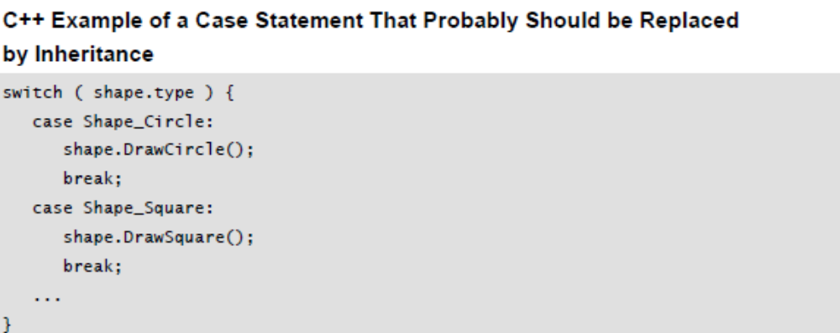
6.3. Design and Implementation Issues
Here is a classic example of code that cries out for a more object-oriented approach:
In this example, the calls to shape.DrawCircle() and shape.DrawSquare() should be replaced by a single routine named shape.Draw(), which can be called regardless of whether the shape is a circle or a square.

Slide 58
6.3. Design and Implementation Issues
In this case, it would be possible to create a base class with derived classes and a polymorphic DoCommand() routine for each command. But the meaning of DoCommand() would be so diluted as to be meaningless, and the case statement is the more understandable solution.
Avoid using a base class’s protected data in a derived class (or make that data private instead of protected in the first place)
As Joshua Bloch says, “Inheritance breaks encapsulation” (2001). When you inherit from an object, you obtain privileged access to that object’s protected routines and data. If the derived class really needs access to the base class’s attributes, provide protected accessor functions instead.

Slide 59
6.3. Design and Implementation Issues
6.3.3. Multiple Inheritance
Inheritance is a power tool. It’s like using a chainsaw to cut down a tree instead of a manual cross-cut saw. It can be incredibly useful when used with care, but it’s dangerous in the hands of someone who doesn’t observe proper precautions.
If inheritance is a chain saw, multiple inheritance is a 1950s-era chain saw with no blade guard, not automatic shut off, and a finicky engine. There are times when such a tool is indispensable, mostly, you’re better off leaving the tool in the garage where it can’t do any damage.
The one indisputable fact about multiple
inheritance in C++ is that it opens up a Pandora’s box of complexities that
simply do not exist under single inheritance.
—Scott Meyers

Slide 60
6.3. Design and Implementation Issues
Although some experts recommend broad use of multiple inheritance (Meyer 1997), in author’s experience multiple inheritance is useful primarily for defining “mixins,” simple classes that are used to add a set of properties to an object.
Mixins are called mixins because they allow properties to be “mixed in” to
derived classes. Mixins might be classes like Displayable, Persistant,
Serializable, or Sortable. Mixins are nearly always abstract and aren’t meant to be instantiated independently of other objects.
Mixins require the use of multiple inheritance, but they aren’t subject to the classic diamond-inheritance problem associated with multiple inheritance as long as all mixins are truly independent of each other. They also make the design more comprehensible by “chunking” attributes together. A programmer will have an easier time understanding that an object uses the mixins Displayable and Persistant than understanding that an object uses the 11 more specific routines that would otherwise be needed to implement those two properties.

Slide 61
6.3. Design and Implementation Issues
Java and Visual Basic recognize the value of mixins by allowing multiple inheritance of interfaces but only single class inheritance. C++ supports multiple inheritance of both interface and implementation. Programmers should use multiple inheritance only after carefully considering the alternatives and weighing the impact on system complexity and comprehensibility.

Slide 62
6.3. Design and Implementation Issues
6.3.4. Why Are There So Many Rules for Inheritance?
This section has presented numerous rules for staying out of trouble with inheritance. The underlying message of all these rules is that, inheritance tends to work against the primary technical imperative you have as a programmer, which is to manage complexity. For the sake of controlling complexity you should maintain a heavy bias against inheritance.
Here’s a summary of when to use inheritance and when to use containment:
● If multiple classes share common data but not behavior, then create a common object that those classes can contain.
● If multiple classes share common behavior but not data, then derive them from a common base class that defines the common routines.
● If multiple classes share common data and behavior, then inherit from a common base class that defines the common data and routines.
● Inherit when you want the base class to control your interface; contain when you want to control your interface.

Slide 63
6.3. Design and Implementation Issues
6.3.5. Member Functions and Data
Here are a few guidelines for implementing member functions and member data effectively.
Keep the number of routines in a class as small as possible
A study of C++ programs found that higher numbers of routines per class were associated with higher fault rates (Basili, Briand, and Melo 1996). However, other competing factors were found to be more significant, including deep inheritance trees, large number of routines called by a routine, and strong coupling between classes. Evaluate the tradeoff between minimizing the number of routines and these other factors.

Slide 64
6.3. Design and Implementation Issues
Disallow implicitly generated member functions and operators you don’t want
Sometimes you’ll find that you want to disallow certain functions—perhaps you want to disallow assignment, or you don’t want to allow an object to be constructed. You might think that, since the compiler generates operators automatically, you’re stuck allowing access. But in such cases you can disallow those uses by declaring the constructor, assignment operator, or other function or operator private, which will prevent clients from accessing it. (Making the constructor private is a standard technique for defining a singleton class, which is discussed later in this chapter.)
Minimize direct routine calls to other classes
One study found that the number of faults in a class was statistically correlated with the total number of routines that were called from within a class (Basili, Briand, and Melo 1996). The same study found that the more classes a class used, the higher its fault rate tended to be.

Slide 65
6.3. Design and Implementation Issues
Minimize indirect routine calls to other classes
Direct connections are hazardous enough. Indirect connections—such as account.ContactPerson().DaytimeContactInfo().PhoneNumber()—tend to be even more hazardous. Researchers have formulated a rule called the “Law of Demeter” (Lieberherr and Holland 1989) which essentially states that Object A can call any of its own routines. If Object A instantiates an Object B, it can call any of Object B’s routines. But it should avoid calling routines on objects provided by Object B. In the account example above, that means account.ContactPerson() is OK, but account.ContactPerson().DaytimeContactInfo() is not.
This is a simplified explanation, and, depending on how classes are arranged, it might be acceptable to see an expression like account.ContactPerson().DaytimeContactInfo().

Slide 66
6.3. Design and Implementation Issues
In general, minimize the extent to which a class collaborates with other classes
Try to minimize all of the following:
● Number of kinds of objects instantiated
● Number of different direct routine calls on instantiated objects
● Number of routine calls on objects returned by other instantiated objects

Slide 67
6.3. Design and Implementation Issues
6.3.6. Constructors
Here are some guidelines that apply specifically to constructors. Guidelines for constructors are pretty similar across languages (C++, Java, and Visual Basic, anyway). Destructors vary more.
Initialize all member data in all constructors, if possible
Initializing all data members in all constructors is an inexpensive defensive programming practice.
Initialize data members in the order in which they’re declared
Depending on your compiler, you can experience some squirrelly errors by trying to initialize data members in a different order than the order in which they’re declared. Using the same order in both places also provides consistency that makes the code easier to read.

Slide 68
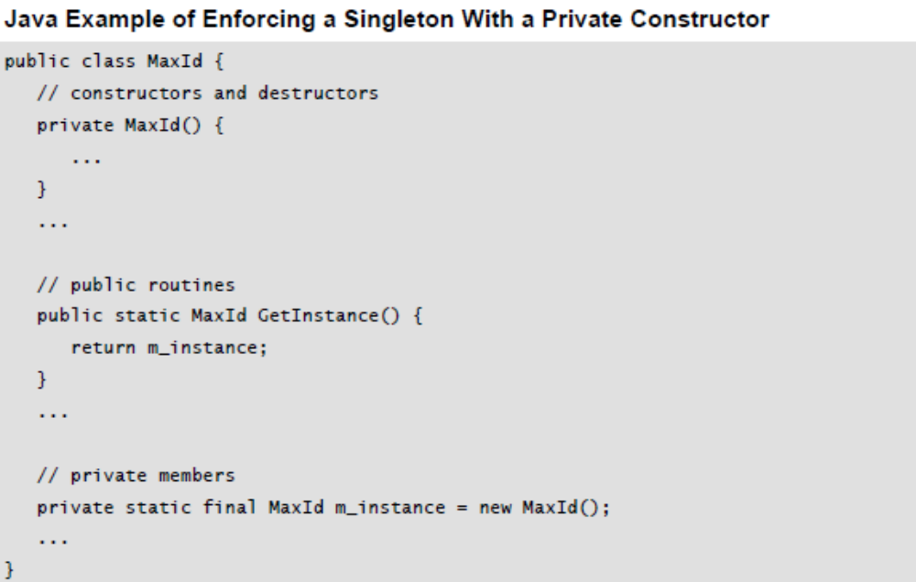
6.3. Design and Implementation Issues
Enforce the singleton property by using a private constructor
If you want to define a class that allows only one object to be instantiated, you can enforce this by hiding all the constructors of the class, then providing a static getInstance() routine to access the class’s single instance. Here’s an example of how that would work:

Slide 69
6.3. Design and Implementation Issues
The private constructor is called only when the static object m_instance is initialized. In this approach, if you want to reference the MaxId singleton, you would simply refer to MaxId.GetInstance().
Enforce the singleton property by using all static member data and reference counting
An alternative means of enforcing the singleton property is to declare all the class’s data static. You can determine whether the class is being used by incrementing a reference counter in the object’s constructor and decrementing it in the destructor (C++) or Terminate routine (Java and Visual Basic).
The reference-counting approach comes with some systemic pitfalls. If the reference is copied, then the class data member won’t necessarily be incremented, which can lead to an error in the reference count. If this approach is used, the project team should standardize on conventions to use reference counted objects consistently.

Slide 70
6.3. Design and Implementation Issues
Prefer deep copies to shallow copies until proven otherwise
One of the major decisions you’ll make about complex objects is whether to implement deep copies or shallow copies of the object. A deep copy of an object is a member-wise copy of the object’s member data. A shallow copy typically just points to or refers to a single reference copy.
Deep copies are simpler to code and maintain than shallow copies. In addition to the code either kind of object would contain, shallow copies add code to count references, ensure safe object copies, safe comparisons, safe deletes, and so on. This code tends to be error prone, and it should be avoided unless there’s a compelling reason to create it. The motivation for creating shallow copies is typically to improve performance.
Although creating multiple copies of large objects might be aesthetically offensive, it rarely causes any measurable performance impact. A small number of objects might cause performance issues, but programmers are notoriously poor at guessing which code really causes problems. Because it’s a poor tradeoff to add complexity for dubious performance gains, a good approach to deep vs. shallow copies is to prefer deep copies until proven otherwise.

Slide 71
6.3. Design and Implementation Issues
If you find that you do need to use a shallow-copy approach, Scott Meyers’ More Effective C++, Item 29 (1996) contains an excellent discussion of the issues in C++.
Martin Fowler’s Refactoring (1999) describes the specific steps needed to convert from shallow copies to deep copies and from deep copies to shallow copies. (Fowler calls them reference objects and value objects.)

Slide 72
6.4. Reasons to Create a Class
If you believe everything you read, you might get the idea that the only reason to create a class is to model real-world objects. In practice, classes get created for many more reasons than that. Here’s a list of good reasons to create a class.
Model real-world objects
Modeling real-world objects might not be the only reason to create a class, but it’s still a good reason! Create a class for each real-world object that your program models. Put the data needed for the object into the class, and then build service routines that model the behavior of the object. See the discussion of ADTs in Section 6.1 for examples.
Model abstract objects
Another good reason to create a class is to model an abstract object—an object that isn’t a concrete, real-world object, but that provides an abstraction of other concrete objects. A good example is the classic Shape object. Circle and Square really exist, but Shape is an abstraction of other specific shapes.

Slide 73
6.4. Reasons to Create a Class
On programming projects, the abstractions are not ready made the way Shape is, so we have to work harder to come up with clean abstractions. The process of distilling abstract concepts from real-world entities is non-deterministic, and different designers will abstract out different generalities.
If we didn’t know about geometric shapes like circles, squares and triangles, for example, we might come up with more unusual shapes like squash shape, rutabaga shape, and Pontiac Aztek shape. Coming up with appropriate abstract objects is one of the major challenges in object-oriented design.
Reduce complexity
The single most important reason to create a class is to reduce a program’s complexity. Create a class to hide information so that you won’t need to think about it. Sure, you’ll need to think about it when you write the class. But after it’s written, you should be able to forget the details and use the class without any knowledge of its internal workings. Other reasons to create classes—minimizing code size, improving maintainability, and improving correctness—are also good reasons, but without the abstractive power of classes, complex programs would be impossible to manage intellectually.

Slide 74
6.4. Reasons to Create a Class
Isolate complexity
Complexity in all forms—complicated algorithms, large data sets, intricate
communications protocols, and so on—is prone to errors. If an error does occur, it will be easier to find if it isn’t spread through the code but is localized within a class. Changes arising from fixing the error won’t affect other code because only one class will have to be fixed—other code won’t be touched. If you find a better, simpler, or more reliable algorithm, it will be easier to replace the old algorithm if it has been isolated into a class. During development, it will be easier to try several designs and keep the one that works best.
Hide implementation details
The desire to hide implementation details is a wonderful reason to create a class whether the details are as complicated as a convoluted database access or as mundane as whether a specific data member is stored as a number or a string.

Slide 75
6.4. Reasons to Create a Class
Limit effects of changes
Isolate areas that are likely to change so that the effects of changes are limited to the scope of a single class or, at most, a few classes. Design so that areas that are most likely to change are the easiest to change. Areas likely to change include hardware dependencies, input/output, complex data types, and business rules.
Hide global data
If you need to use global data, you can hide its implementation details behind a class interface. Working with global data through access routines provides several benefits compared to working with global data directly. You can change the structure of the data without changing your program. You can monitor accesses to the data. The discipline of using access routines also encourages you to think about whether the data is really global; it often becomes apparent that the “global data” is really just class data.

Slide 76
6.4. Reasons to Create a Class
Streamline parameter passing
If you’re passing a parameter among several routines, that might indicate a need to factor those routines into a class that share the parameter as class data. Streamlining parameter passing isn’t a goal, per se, but passing lots of data around suggests that a different class organization might work better.
Make central points of control
It’s a good idea to control each task in one place. Control assumes many forms. Knowledge of the number of entries in a table is one form. Control of devices—files, database connections, printers, and so on—is another. Using one class to read from and write to a database is a form of centralized control. If the database needs to be converted to a flat file or to in-memory data, the changes will affect only the one class.
The idea of centralized control is similar to information hiding, but it has unique heuristic power that makes it worth adding to your programming toolbox.

Slide 77
6.4. Reasons to Create a Class
Facilitate reusable code
Code put into well-factored classes can be reused in other programs more easily than the same code embedded in one larger class. Even if a section of code is called from only one place in the program and is understandable as part of a larger class, it makes sense to put it into its own class if that piece of code might be used in another program.
NASA’s Software Engineering Laboratory studied ten projects that pursued reuse aggressively (McGarry, Waligora, and McDermott 1989). In both the object-oriented and the functionally oriented approaches, the initial projects weren’t able to take much of their code from previous projects because previous projects hadn’t established a sufficient code base. Subsequently, the projects that used functional design were able to take about 35 percent of their code from previous projects. Projects that used an object-oriented approach were able to take more than 70 percent of their code from previous projects. If you can avoid writing 70 percent of your code by planning ahead, do it!

Slide 78
6.4. Reasons to Create a Class
Notably, the core of NASA’s approach to creating reusable classes does not involve “designing for reuse.” NASA identifies reuse candidates at the ends of their projects. They then perform the work needed to make the classes reusable as a special project at the end of the main project or as the first step in a new project. This approach helps prevent “gold-plating”—creation of functionality that isn’t required and that adds complexity unnecessarily.

Slide 79
6.4. Reasons to Create a Class
Plan for a family of programs
If you expect a program to be modified, it’s a good idea to isolate the parts that you expect to change by putting them into their own classes. You can then modify the classes without affecting the rest of the program, or you can put in completely new classes instead. Thinking through not just what one program will look like, but what the whole family of programs might look like is a powerful heuristic for anticipating entire categories of changes (Parnas 1976).
Several years ago I managed a team that wrote a series of programs used by our clients to sell insurance. We had to tailor each program to the specific client’s insurance rates, quote-report format, and so on. But many parts of the programs were similar: the classes that input information about potential customers, that stored information in a customer database, that looked up rates, that computed total rates for a group, and so on. The team factored the program so that each part that varied from client to client was in its own class. The initial programming might have taken three months or so, but when we got a new client, we merely wrote a handful of new classes for the new client and dropped them into the rest of the code. A few days’ work, and voila! Custom software!

Slide 80
6.4. Reasons to Create a Class
Package related operations
In cases in which you can’t hide information, share data, or plan for flexibility, you can still package sets of operations into sensible groups such as trig functions, statistical functions, string-manipulation routines, bit-manipulation routines, graphics routines, and so on.
To accomplish a specific refactoring
Many of the specific refactorings described in Chapter 24 result in new classes—including converting one class to two, hiding a delegate, removing a middle man, and introducing an extension class. These new classes could be motivated by a desire to better accomplish any of the objectives described throughout this section.

Slide 81
6.4. Reasons to Create a Class
6.4.1. Classes to Avoid
While classes in general are good, you can run into a few gotchas. Here are some classes to avoid.
Avoid creating god classes
Avoid creating omniscient classes that are all-knowing and all-powerful. If a class spends its time retrieving data from other classes using Get() and Set() routines (that is, digging into their business and telling them what to do), ask whether that functionality might better be organized into those other classes rather than into the god class (Riel 1996).
Eliminate irrelevant classes
If a class consists only of data but no behavior, ask yourself whether it’s really a class and consider demoting it to become an attribute of another class.
Avoid classes named after verbs
A class that has only behavior but no data is generally not really a class. Consider turning a class like DatabaseInitialization() or StringBuilder() into a routine on some other class.

Slide 82
6.4. Reasons to Create a Class
6.4.2. Summary of Reasons to Create a Class
Here’s a summary list of the valid reasons to create a class:
● Model real-world objects
● Model abstract objects
● Reduce complexity
● Isolate complexity
● Hide implementation details
● Limit effects of changes
● Hide global data
● Streamline parameter passing
● Make central points of control
● Facilitate reusable code
● Plan for a family of programs
● Package related operations
● To accomplish a specific refactoring

Slide 83
6.5. Language-Specific Issues
Approaches to classes in different programming languages vary in interesting ways. Consider how you override a member routine to achieve polymorphism in a derived class.
In Java, all routines are overridable by default, and a routine must be declared final to prevent a derived class from overriding it.
In C++, routines are not overridable by default. A routine must be declared virtual in the base class to be overridable.
In Visual Basic, a routine must be declared overridable in the base class, and the derived class should use the overrides keyword.

Slide 84
6.5. Language-Specific Issues
Here are some of the class-related areas that vary significantly depending on the language:
● Behavior of overridden constructors and destructors in an inheritance tree
● Behavior of constructors and destructors under exception-handling conditions
● Importance of default constructors (constructors with no arguments)
● Time at which a destructor or finalizer is called
● Wisdom of overriding the language’s built-in operators, including assignment and equality
● How memory is handled as objects are created and destroyed, or as they are declared and go out of scope

Slide 85
6.6. Beyond Classes: Packages
Classes are currently the best way for programmers to achieve modularity. But modularity is a big topic, and it extends beyond classes. Over the past several decades, software development has advanced in large part by increasing the granularity of the aggregations that we have to work with.
The first aggregation we had was the statement, which at the time seemed like a big step up from machine instructions. Then came subroutines, and later came classes.
It’s evident that we could better support the goals of abstraction and encapsulation if we had good tools for aggregating groups of objects. Ada supported the notion of packages more than a decade ago, and Java supports packages today.
C++’s and C#’s namespaces are a good step in the right direction, though creating packages with them is a little bit like writing web pages directly in html.

Slide 86
6.6. Beyond Classes: Packages
If you’re programming in a language that doesn’t support packages directly, you can create your own poor-programmer’s version of a package and enforce it through programming standards that include
● naming conventions that differentiate which classes are public and which are for the package’s private use
● naming conventions, code-organization conventions (project structure), or both that identify which package each class belongs to
● Rules that define which packages are allowed to use which other packages, including whether the usage can be inheritance, containment, or both These workaround are good examples of the distinction between programming in a language vs. programming into a language.

Slide 87
6.7. CHECKLIST: Class Quality
Abstract Data Types
- Have you thought of the classes in your program as Abstract Data Types and evaluated their interfaces from that point of view?
Abstraction
- Does the class have a central purpose?
- Is the class well named, and does its name describe its central purpose?
- Does the class’s interface present a consistent abstraction?
- Does the class’s interface make obvious how you should use the class?
- Is the class’s interface abstract enough that you don’t have to think about how its services are implemented? Can you treat the class as a black box?
- Are the class’s services complete enough that other classes don’t have to meddle with its internal data?
- Has unrelated information been moved out of the class?
- Have you thought about subdividing the class into component classes, and have you subdivided it as much as you can?
- Are you preserving the integrity of the class’s interface as you modify the class?

Slide 88
6.7. CHECKLIST: Class Quality
Encapsulation
- Does the class minimize accessibility to its members?
- Does the class avoid exposing member data?
- Does the class hide its implementation details from other classes as much as the programming language permits?
- Does the class avoid making assumptions about its users, including its derived classes?
- Is the class independent of other classes? Is it loosely coupled?
Inheritance
- Is inheritance used only to model “is a” relationships?
- Does the class documentation describe the inheritance strategy?
- Do derived classes adhere to the Liskov Substitution Principle?
- Do derived classes avoid “overriding” non overridable routines?
- Are common interfaces, data, and behavior as high as possible in the inheritance tree?
- Are inheritance trees fairly shallow?
- Are all data members in the base class private rather than protected?

Slide 89
6.7. CHECKLIST: Class Quality
Other Implementation Issues
- Does the class contain about seven data members or fewer?
- Does the class minimize direct and indirect routine calls to other classes?
- Does the class collaborate with other classes only to the extent absolutely necessary?
- Is all member data initialized in the constructor?
- Is the class designed to be used as deep copies rather than shallow copies unless there’s a measured reason to create shallow copies?
Language-Specific Issues
- Have you investigated the language-specific issues for classes in your specific programming language?

